Slide 1
Network-based association study of protein sets and applications in gene ontology enrichment analysis
Abstract: (165 words)
We present a protocol of Network-Based Association Study (NetBAS) that interprets gene ontology (GO) annotations associated with protein sets by mapping to cellular protein-protein interaction (PPI) networks. The rational of network-based methodologies for GO enrichment analysis resides in the fact that proteins conduct functions as communities and through interacting with other proteins inside or at the surface of the cell. NetBAS inspects a protein set versus null permutations to evaluate the annotation terms that are over-expressed in neighbor proteins interacting with members of the protein set. We tested 50 hallmark sets from MSigDB using NetBAS. We found that the modular structures of the subnetworks constituted by the protein sets strongly influence the enrichment scores. We compared NetBAS with two other tools, a modular enrichment tool, DAVID, and a network-topology-based tool, WebGestalt. We demonstrate that NetBAS covers the network-architecture and can serve as a useful complement in GO enrichment analysis. Moreover, NetBAS can be applied to analyze other categorical or quantitative data associated with protein sets.

Slide 2
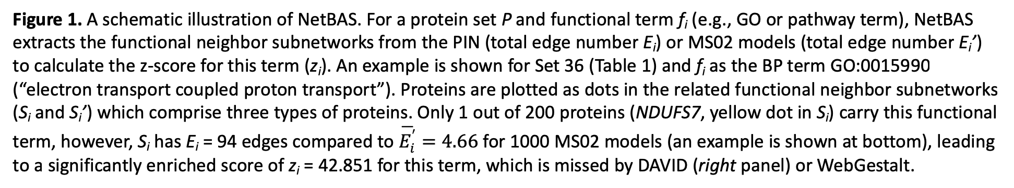
Figure 1. A schematic illustration of NetBAS. For a protein set P and functional term f_{i} (e.g., GO or pathway term), NetBAS extracts the functional neighbor subnetworks from the PIN (total edge number E_{i}) or MS02 models (total edge number E_{i}’) to calculate the z-score for this term (z_{i}). An example is shown for Set 36 (Table 1) and f_{i} as the BP term GO:0015990 (“electron transport coupled proton transport”). Proteins are plotted as dots in the related functional neighbor subnetworks (S_{i} and S_{i}’) which comprise three types of proteins. Only 1 out of 200 proteins (NDUFS7, yellow dot in S_{i}) carry this functional term, however, S_{i} has E_{i} = 94 edges compared to $\overline{E_{i}^{′}}=4.66$ for 1000 MS02 models (an example is shown at bottom), leading to a significantly enriched score of z_{i} = 42.851 for this term, which is missed by DAVID (right panel) or WebGestalt.

Slide 3
Table 1. Summary of the 50 hallmark protein sets from MSigDB (only 10 are listed)
Set | V | E | Iso | D_{max} | CC | Clust | Cliq | R | B | Y | BP¹⁰ | CC¹⁰ | MF¹⁰ | BP_{max} | CC_{max} | MF_{max}
1 | 200 | 445 | 29 | 159 | 0.123 | 171 | 10 | 49 | 37 | 6 | 10 | 8 | 5 | 18.434 | 26.675 | 18.010
2 | 200 | 616 | 26 | 40 | 0.398 | 166 | 11 | 103 | 63 | 23 | 10 | 10 | 8 | 55.890 | 50.323 | 46.862
3 | 101 | 55 | 52 | 10 | 0.132 | 39 | 3 | 27 | 2 | 0 | 0 | 7 | 2 | 13.983 | 9.221 | 13.150
4 | 36 | 25 | 16 | 6 | 0.224 | 20 | 3 | 22 | 361 | 4 | 7 | 7 | 6 | 32.793 | 23.620 | 24.619
5 | 200 | 570 | 42 | 32 | 0.299 | 150 | 7 | 121 | 190 | 9 | 10 | 10 | 8 | 36.113 | 40.408 | 38.653
6 | 44 | 15 | 27 | 5 | 0.111 | 13 | 3 | 16 | 72 | 3 | 6 | 5 | 0 | 14.174 | 16.512 | 23.880
7 | 161 | 467 | 23 | 42 | 0.215 | 138 | 7 | 98 | 56 | 14 | 10 | 9 | 8 | 27.164 | 19.898 | 28.141
8 | 112 | 89 | 53 | 10 | 0.434 | 53 | 6 | 12 | 19 | 1 | 6 | 9 | 5 | 40.115 | 43.054 | 52.303
9 | 74 | 46 | 42 | 10 | 0.379 | 26 | 5 | 29 | 150 | 11 | 5 | 5 | 1 | 11.587 | 11.525 | 10.507
10 | 138 | 260 | 36 | 28 | 0.203 | 98 | 5 | 45 | 41 | 18 | 9 | 9 | 5 | 47.730 | 45.398 | 53.650
List of protein sets: 1. HALLMARK_ADIPOGENESIS, 2. HALLMARK_ALLOGRAFT_REJECTION, 3. HALLMARK_ANDROGEN_RESPONSE, 4. HALLMARK_ANGIOGENESIS, 5. HALLMARK_APICAL_JUNCTION, 6. HALLMARK_APICAL_SURFACE, 7. HALLMARK_APOPTOSIS, 8. HALLMARK_BILE_ACID_METABOLISM, 9. HALLMARK_CHOLESTEROL_HOMEOSTASIS, 10. HALLMARK_COAGULATION, …
Set: protein sets 1-50; V: vertex number; E: edge number; Iso: number of isolated proteins; D_{max}: maximal vertex degree; ClustC: cluster coefficient (global); Clust: maximal cluster size; Cliq: maximal clique degree; R: number of R-proteins (type-1, Red); B: number of B-proteins (type-2, Blue); Y: number of Y-proteins (type-3, Yellow); BP¹⁰: number of top-10 BP terms that overlap with DAVID; CC¹⁰: number of too-10 CC terms that overlap with DAVID; MF¹⁰: number of top-10 MF terms that overlap with DAVID; BP_{max}: z_{max} for BP terms; CC_{max}: z_{max} for CC terms; MF_{max}: z_{max} for MF terms.

Slide 4
Figure 2. Protein set 20 (A-C) and set 28 (D-H). (A) Protein set 20 constitutes a loosely connexted subnetwork. (B) Top 10 enriched results from the maximal cluster of the subnetwork (C3, 13 proteins, 16 edges) is highly consistent with that from the full set (left, 36 proteins, 21 edges). (C) The functional neighbor subnetwork associated with top enriched BP term f_{i} = GO:1902287 (“semaphorin-plexin signaling pathway involved in axon guidance”) for the full set (top) and c3-only (bottom). The yellow node is NRP1 that carries the BP term and is included in c3 of set 20.

Slide 5
Figure 2 (continued) (D). Protein set 28 constitutes a largely imcomplete subnetwork with 126 isolated nodes. The largest clique (clique1) with a degree of 9 was highlighted in a red circle. A smaller clique (clique2) with a degree of 4 was highlighed in a blue circle. (E) Top 10 enriched results from the full set (left, 200 proteins) and the clique (right, 9 proteins). (F) The functional neighbor subnetwork associated with the BP term GO:0007218 (“neuropeptide signaling pathway”) for the full set (top) and the clique 1-only (bottom).

Slide 6
Figure 2 (continued) (G) The largiest clique of set 28. (H) Venn diagrams of the enriched BP terms using NetBAS (red), DAVID (blue) and WebGestAlt (yellow) for left: all 200 proteins, middle: the 9 proteins from the clique 1, and right: the other 191 proteins except clique 1.

Slide 7
B
R
Y
R (type 1): proteins from set P but do not carry f_{i}
B (type 2): proteins carry f_{i} but do not belong to set P
Y (type 3): protein belong to set P and carry f_{i}
Figure 3. K-means clustering of the protein distributions in the functional neighbor subnetworks of S_{BP1} resulted in three groups from the 50 hallmark protein sets. (A) Cluster I includes 26 sets in which S_{BP1} is dominated by type-2 proteins (blue) that are significantly more than type 1 (red) or type 3 (yellow) proteins. Two examples of S_{BP1} from set 4 and set40 are shown. Set 4 has four Y-type proteins with degrees k(APP)=333, k(PF4)=191, k(CXCL6)=188, and k(VAV2)=14, respectively. The single R-type protein in set40 is GNGT1 with k=377.

Slide 8
B
R
Y
R (type 1): proteins from set P but do not carry f_{i}
B (type 2): proteins carry f_{i} but do not belong to set P
Y (type 3): protein belong to set P and carry f_{i}
Figure 3. (continued) (B) Cluster II includes 12 sets in which numbers of type I and type II proteins in S_{BP1} are close to each other, and both are larger than that of type III proteins. Two examples of S_{BP1} from set1 and set27 are shown.

Slide 9
R
B
Y
Figure 3. (continued) (C) Cluster III includes 12 sets in which type I proteins are higher than type 2 or type 3 proteins in S_{BP1}. Two examples of S_{BP1} from set7 and set3 are shown. Set3 is an extreme case and the only protein set that none of the top-10 enriched BP terms by NetBAS has been captured by DAVID.

Slide 10
Table 2. Average properties of the three clusters of protein sets
Cluster | BP_{max} | R | B | Y | Cliq | Clust | CC_{max} | MF_{max} | BP¹⁰ | CC¹⁰ | MF¹⁰
Cluster1 | 40.4 | 59.8 | 211.7 | 15.6 | 7.3 | 72.5 | 31.8 | 34.5 | 7.3 | 6.6 | 5.2
Cluster2 | 34.3 | 48.3 | 48.2 | 9.3 | 9.4 | 107.8 | 30.8 | 33.6 | 7.0 | 6.9 | 5.0
Cluster3 | 54.1 | 70.6 | 35.6 | 16.3 | 15.8 | 133.4 | 47.7 | 43.4 | 7.8 | 8.1 | 6.8
Cluster3’ | 57.7 | 74.5 | 38.6 | 17.7 | 16.9 | 142 | 51.1 | 46.2 | 8.5 | 8.2 | 7.2
Average values for all protein sets in the cluster. BP_{max}: z_{max} for BP terms; R: number of R-proteins (type-1, Red); B: number of B-proteins (type-2, Blue); Y: number of Y-Proteins (type-3, Yellow); Cliq: maximal clique degree; Clust: maximal cluster size; CC_{max}: z_{max} for CC terms; MF_{max}: z_{max} for MF terms; BP¹⁰: number of top-10 BP terms that overlap with DAVID; CC¹⁰: number of too-10 CC terms that overlap with DAVID; MF¹⁰: number of top-10 MF terms that overlap with DAVID. Cluster3’ is cluster-3 excludes the protein set 3 (Fig. 3C).

Slide 11
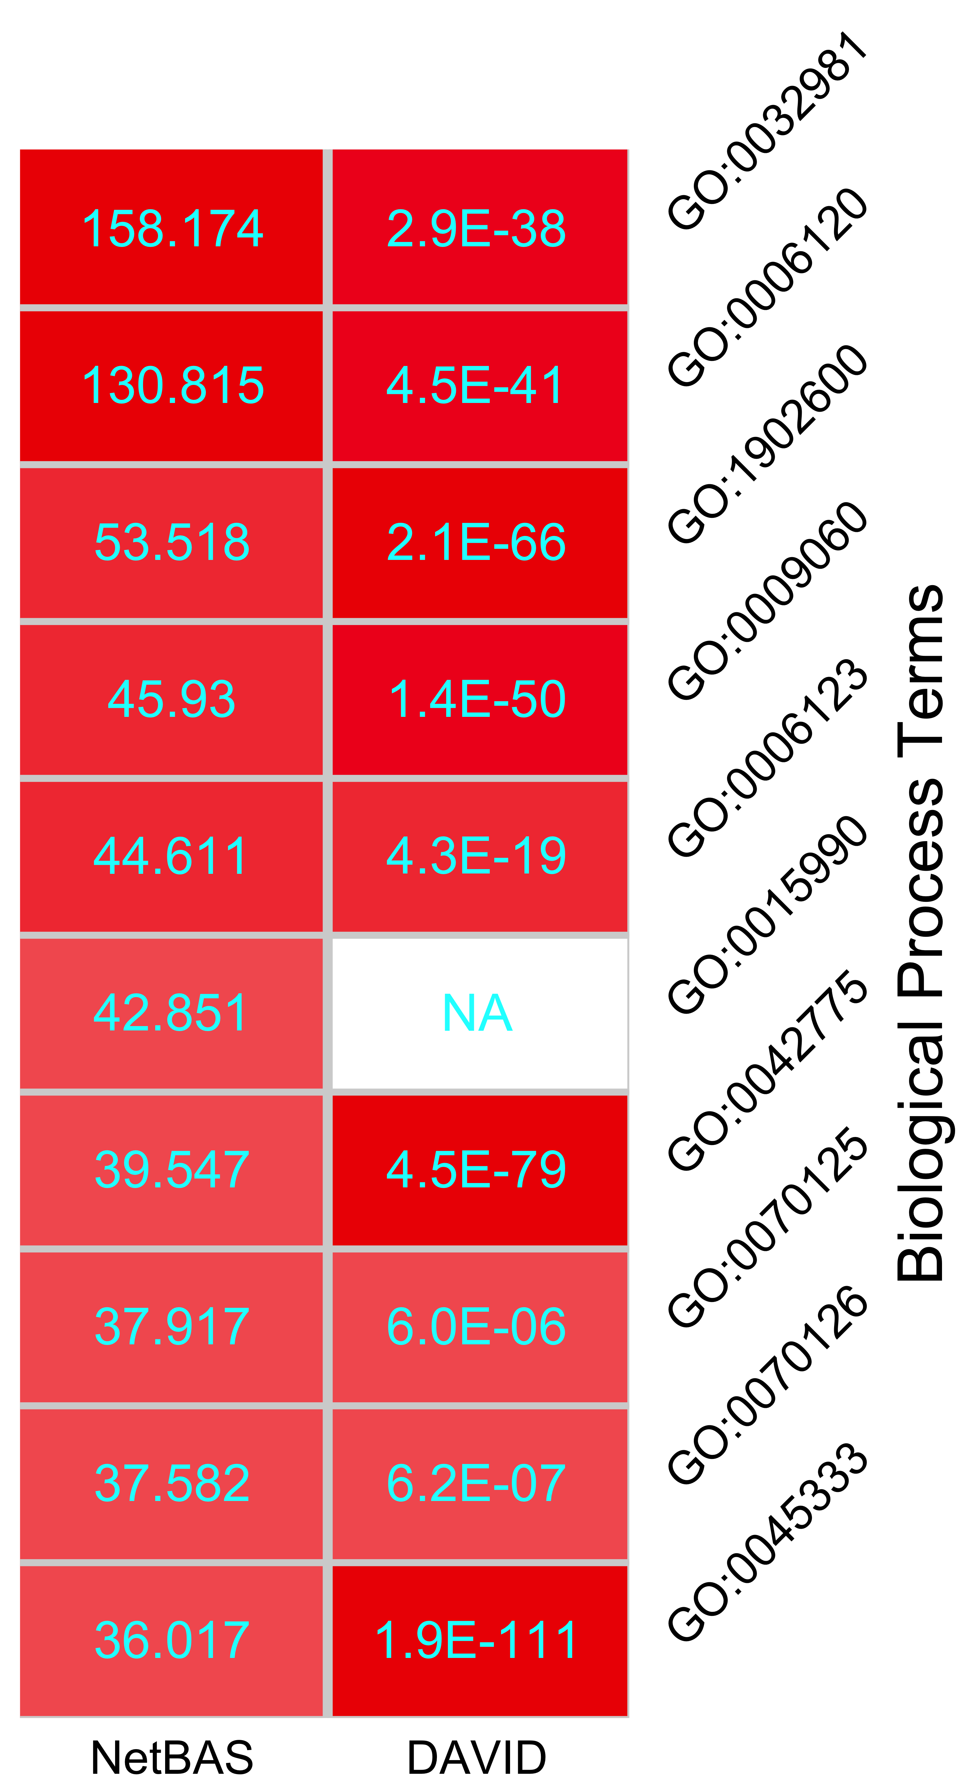
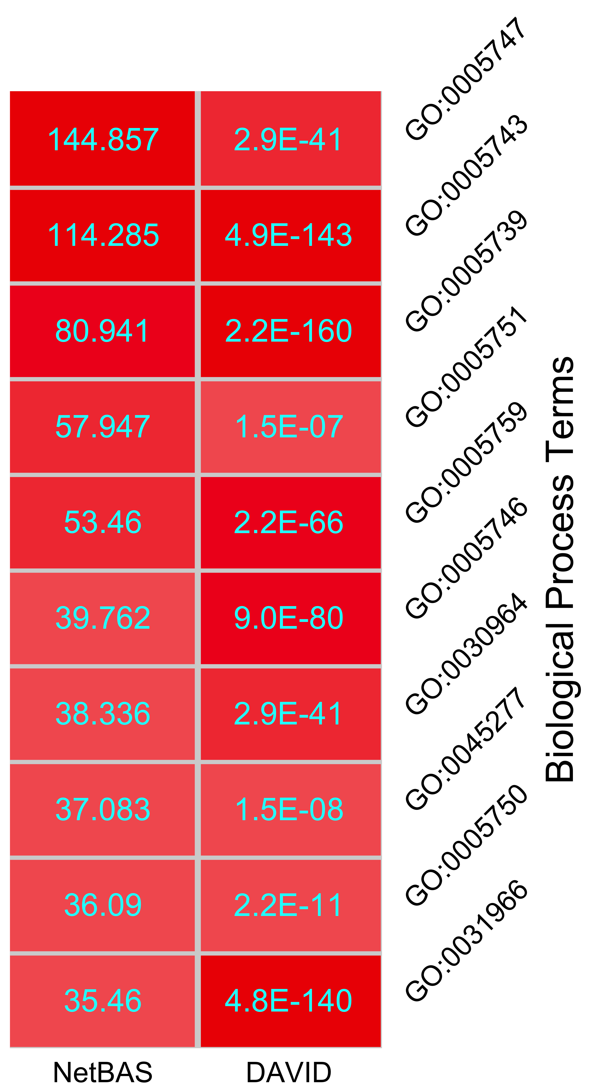
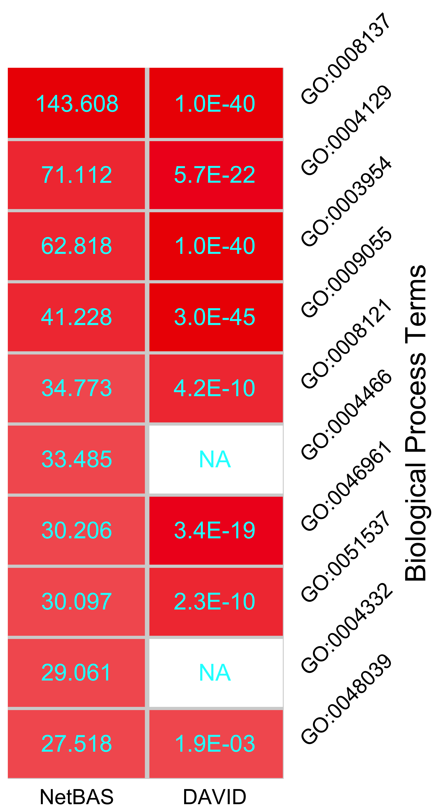
Supplementary Materials
S1. Details of top-10 enriched BP, CC and MF terms, e.g.
S2. Plots of functional neighbor networks
S3. Comparisons between NetBAS and DAVID/WebGestalt
S4. Examples of pathway enrichment
S5. Examples of an alternative node-replacement aproach.
"GO.ID","GO.Term","zscore","obs","mean","std"
"GO:0008134","transcription factor binding","19.387","1619","1022.213","30.783"

